Slide 1



sample financial
View in Power BI
Last data refresh:
23/12/2022 20:30:37 UTC
Downloaded at:
23/12/2022 20:57:19 UTC

Slide 2
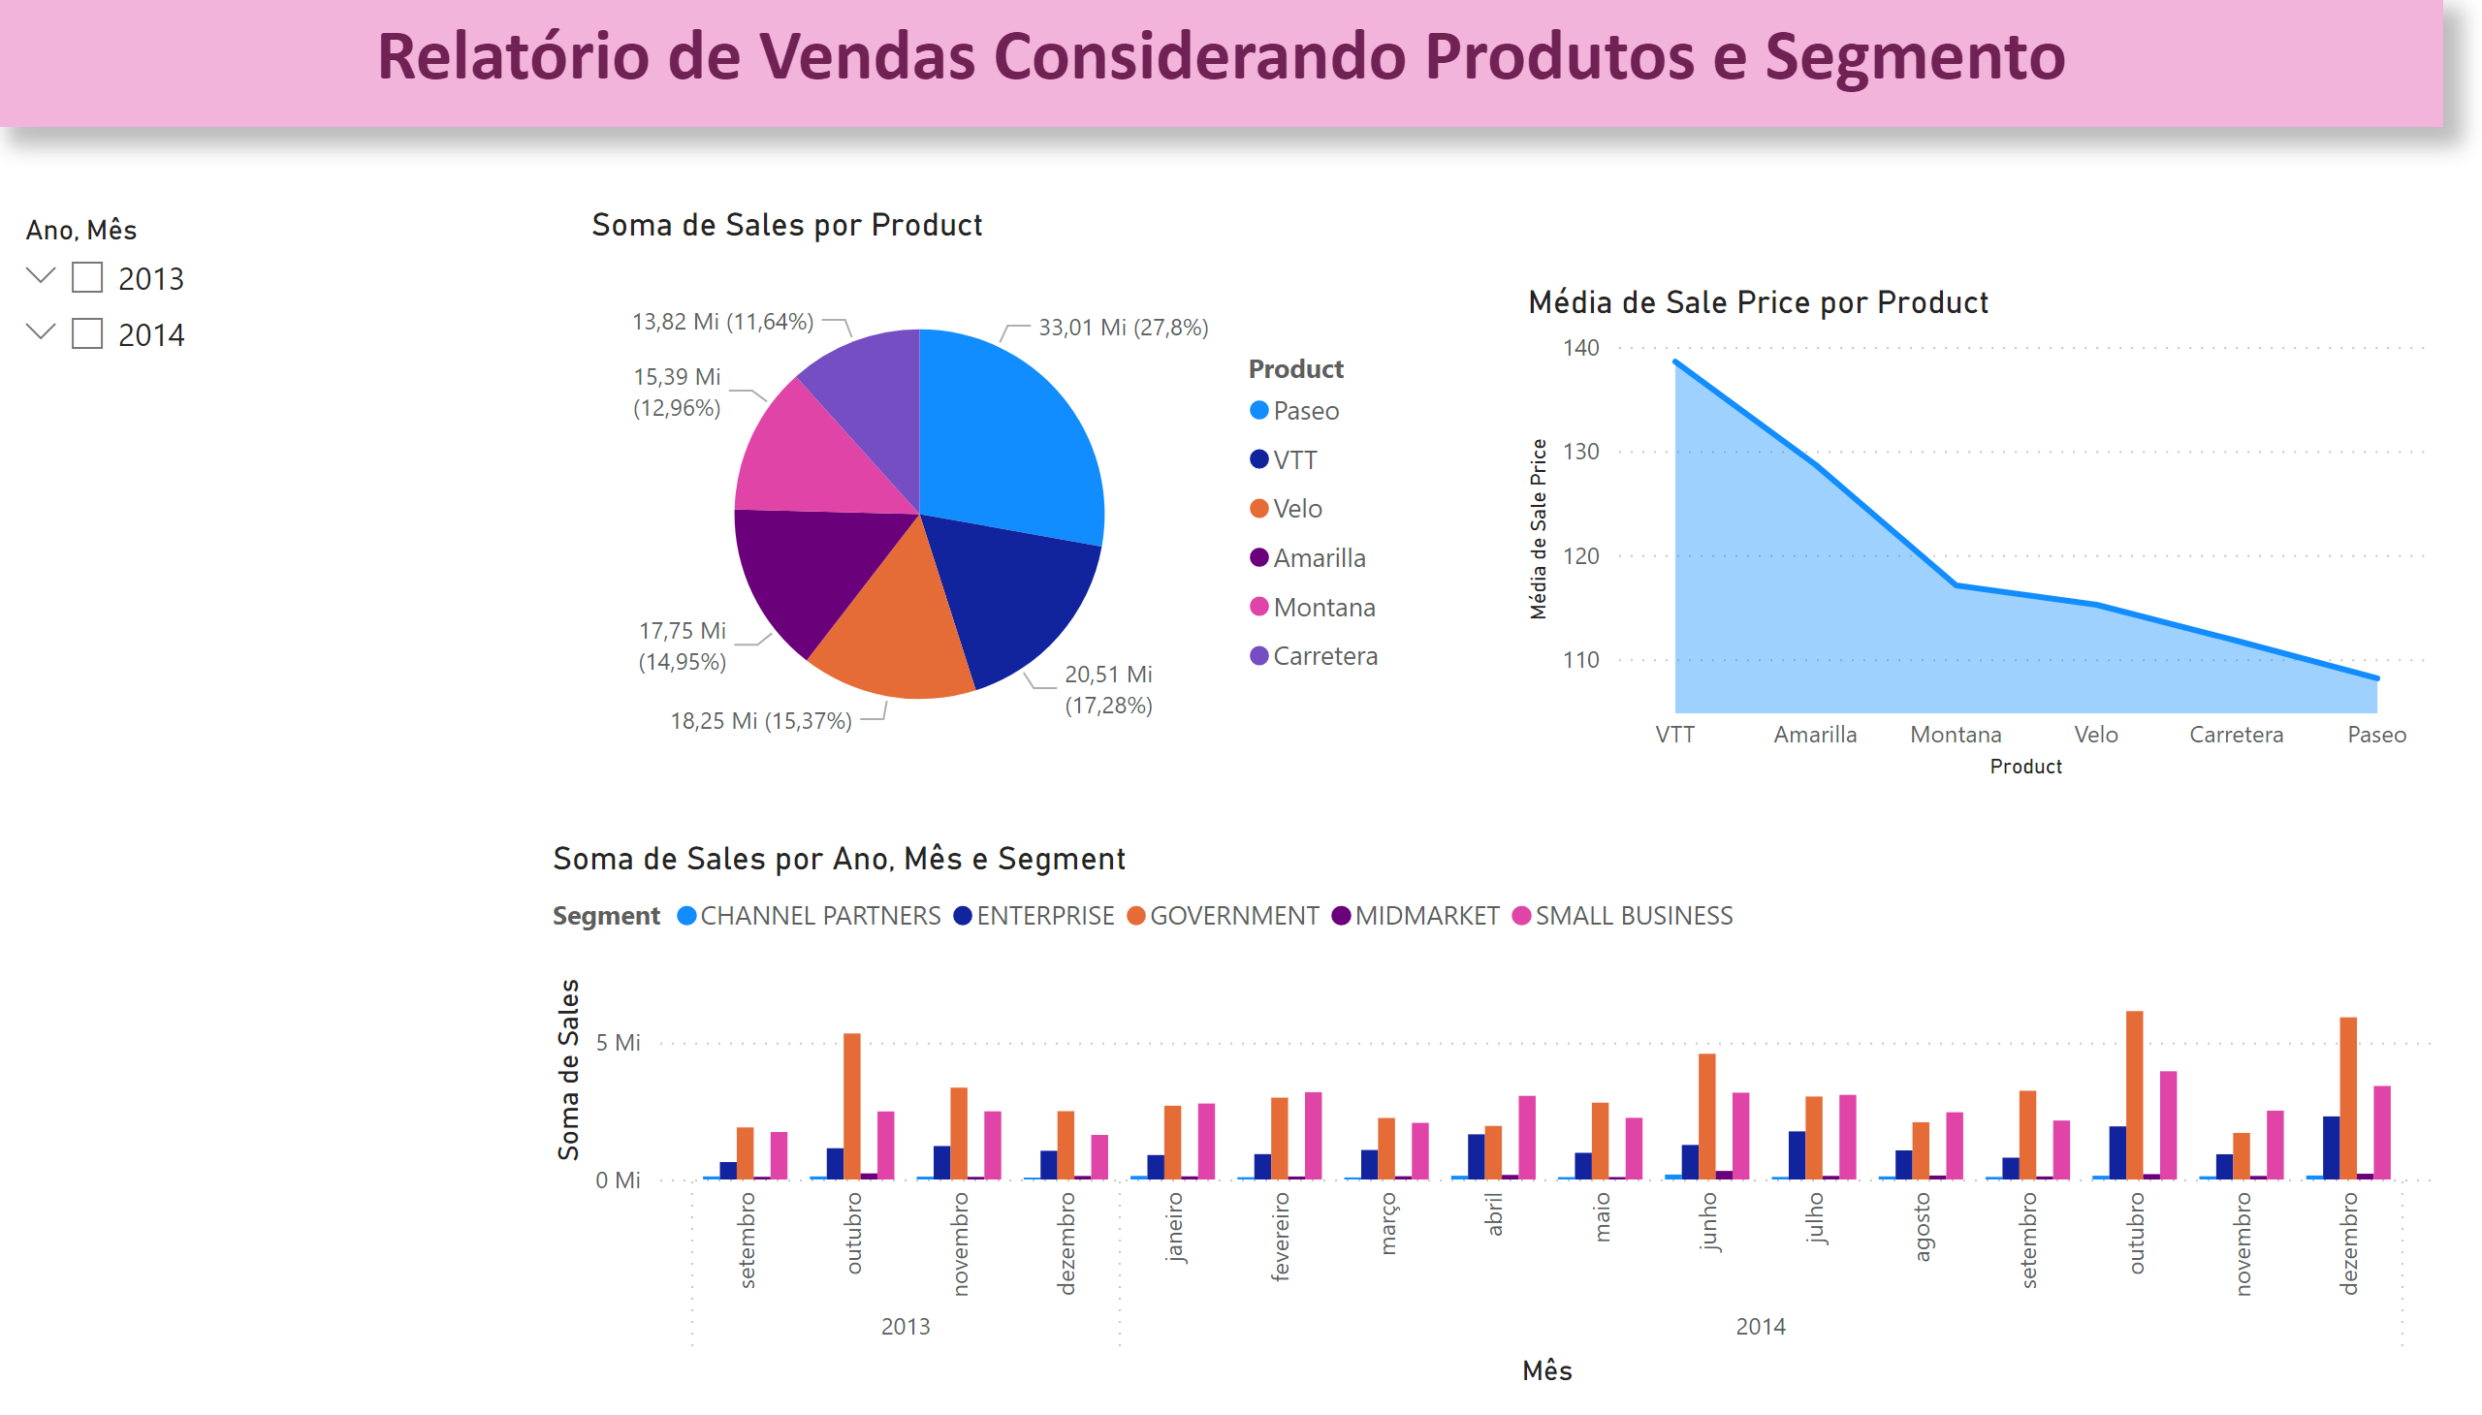
Produto e Segmento
Notes:
pieChart
No alt text provided
areaChart
No alt text provided
clusteredColumnChart
No alt text provided
slicer
No alt text provided
textbox
No alt text provided

Slide 3
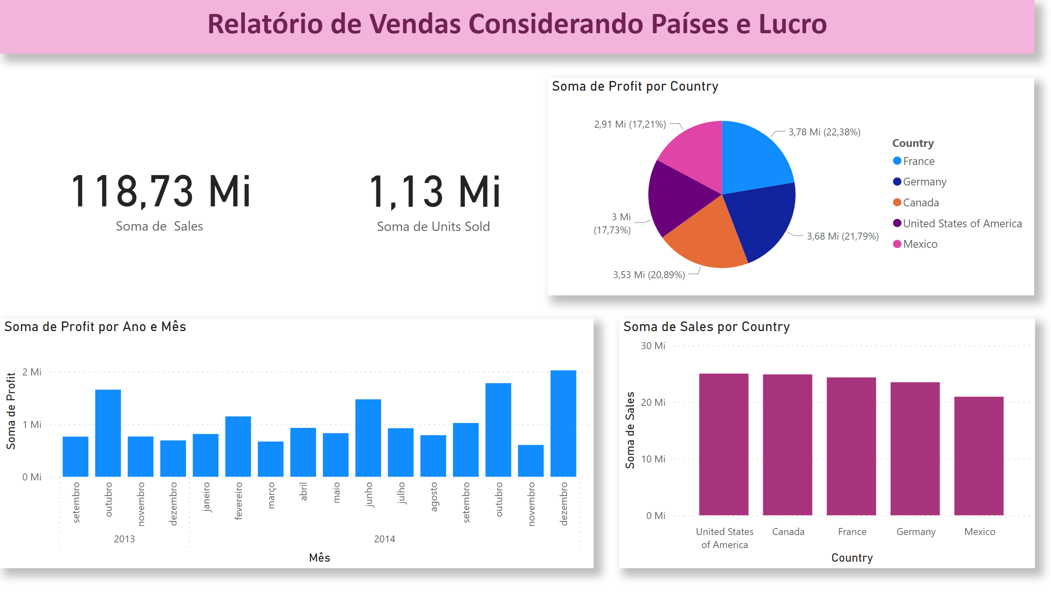
Paises
Notes:
textbox
No alt text provided
card
No alt text provided
card
No alt text provided
pieChart
No alt text provided
clusteredColumnChart
No alt text provided
clusteredColumnChart
No alt text provided

Slide 4
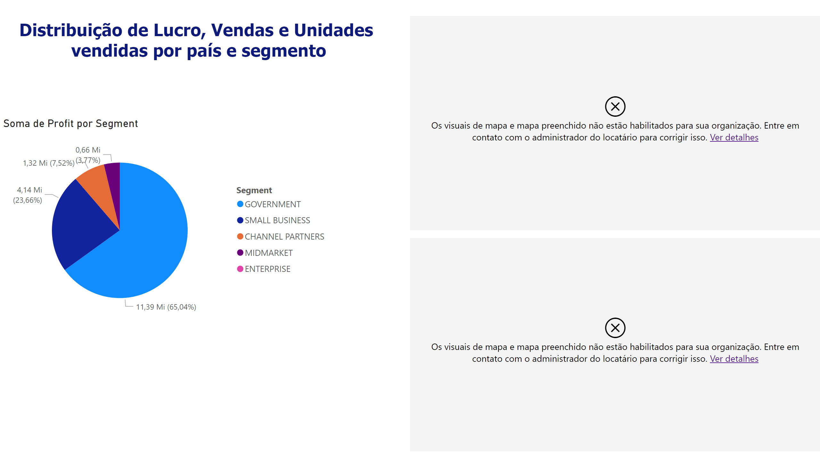
Lucro e Vendas por Segmento
Notes:
pieChart
No alt text provided
map
No alt text provided
map
No alt text provided
textbox
No alt text provided

